Slide 1


GoodsWay
Capstone Project

Slide 2





Team information
Goodsway

Slide 3


Goodsway
Supervisor

Slide 4
Outline
Goodsway
1
Initial Idea
2
Literature review and proposal
3
Project plan
4
System Analysis and Design
5
Implementation and Testing
6
Demo
7
Summary
8
Q&A

Slide 5








Initial Idea
Goodsway
GoodsWay
Initial Idea

Slide 6
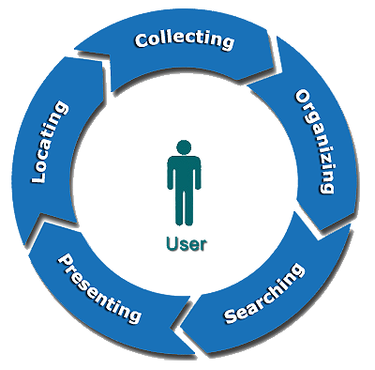
Initial Idea (cont)
Goodsway
From this situation:
We decide to develop a new system that integrated:
Collect information
Organize these information
Searching
Presenting
Locating

Slide 7
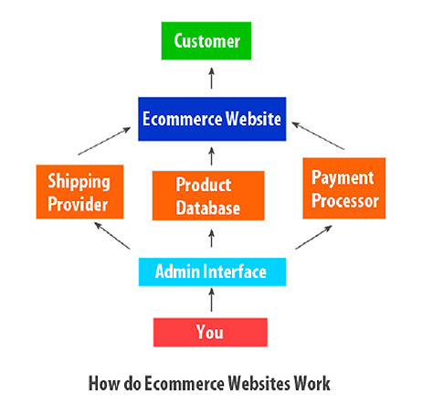
Literature Review
Goodsway
How do e-commerce websites work?

Slide 8
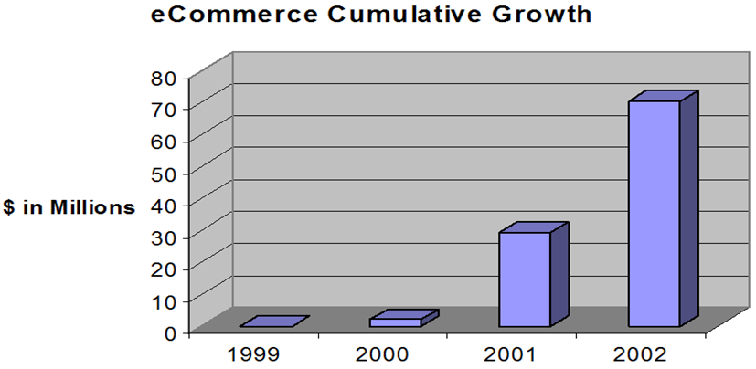
Literature Review
Goodsway

Slide 9
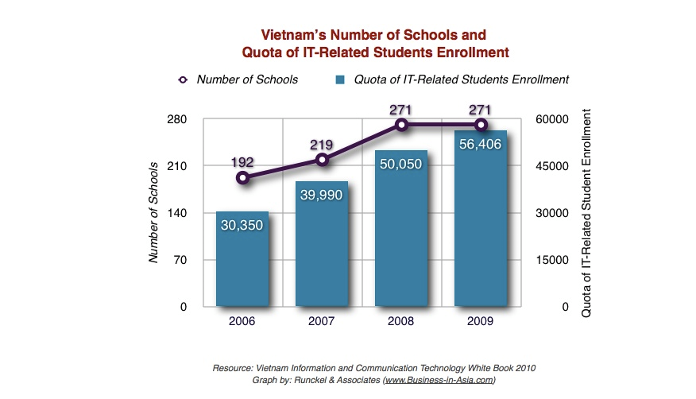
Literature Review
Goodsway

Slide 10
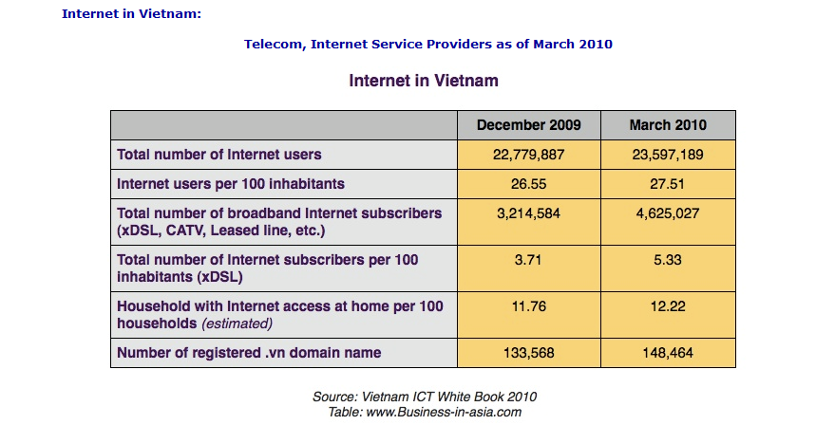
Literature Review
Goodsway

Slide 11
Literature Review (cont)
Goodsway
Overview of e-commerce in Vietnam
Criterias | Assess
Infrastructures | Good
Internet accesss | Good
Professional personnel | Medium
Knowledge about e-commerce | Medium
Community perception | Good
Laws | Bad

Slide 12
Literature Review (cont)
Goodsway
Achievements of the existing systems
Existing systems
Transaction value
Attractive
Advertisement

Slide 13
Literature Review (cont)
Goodsway
Limitations of the existing systems
Searching speed
HCI issues
Existing systems

Slide 14
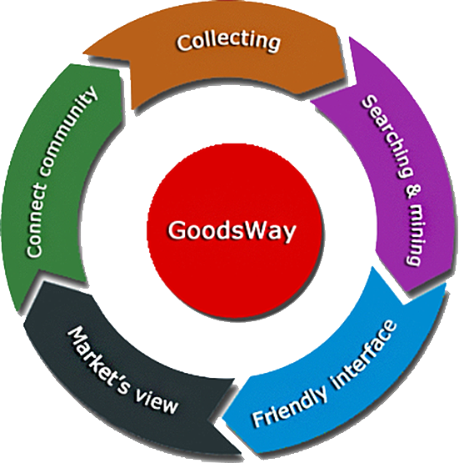
Proposal
Goodsway

Slide 15
Project plan
Goodsway
Technology selection
Project schedule
Risk management
Software process model selection
Roles and Responsibilities

Slide 16
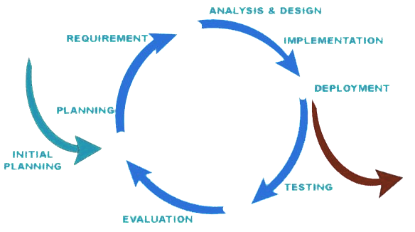
Project plan (cont)
Goodsway
Software process model selection
Iterative Model
Implementing each specific part
Continue review and improvement

Slide 17
Supervisor (Mr.DungHA, Mr.TrungNT)
Sales (CanhBX, DungTQ)
Customer (FPT University)
Project Manager (CanhBX)
IT supporting team (TuanQX, NinhVH)
QA Team (CanhBX, DungTQ)
Other stakeholders
Analysis team (Canh, Duy, Ninh, Tuan, Dung)
Development team (Dung, Ninh, Duy, Tuan, Canh)
Test team (DuyDH, NinhVH, TuanQX)
Customer Support team (DungTQ, CanhBX)
Design team (DuyDH, DungTQ)
Deployment team (NinhVH, DuyDH)
Subcontract Manager (Ninh, Dung)
Configuration controller (Canh, Tuan)

Slide 18



Project plan (cont)
Goodsway
Technology selection
PHP
MySQL
Apache Tomcat
Reason
Open source
Multi-platform
Wide community support

Slide 19
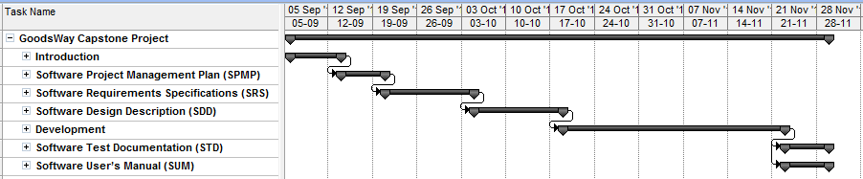
Project plan – timeline
Goodsway
Overall plan

Slide 20
Project plan – risk management
Goodsway
Risk
Management
People risk
Estimation risk
Technology risk
Requirement risk
Schedule risk

Slide 21
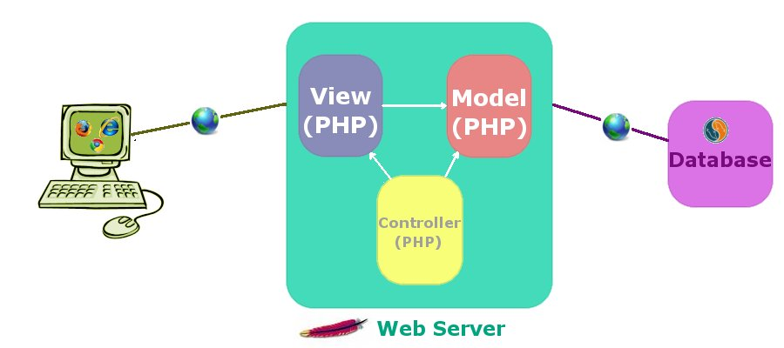
System analysis and design
Goodsway
“GoodsWay” web application built with MVC in general view.

Slide 22
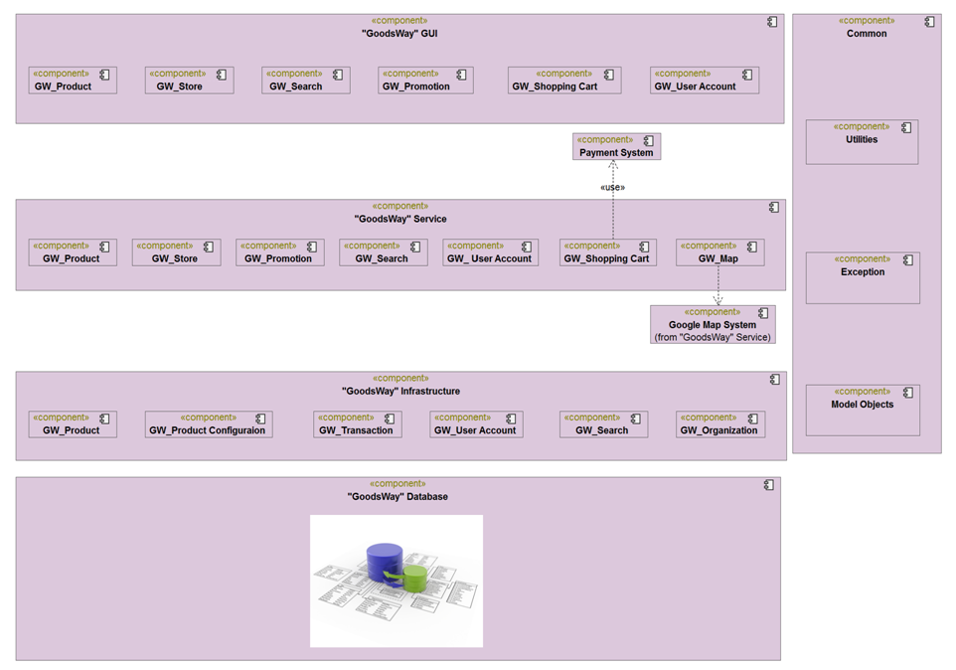
System analysis & design

Slide 23
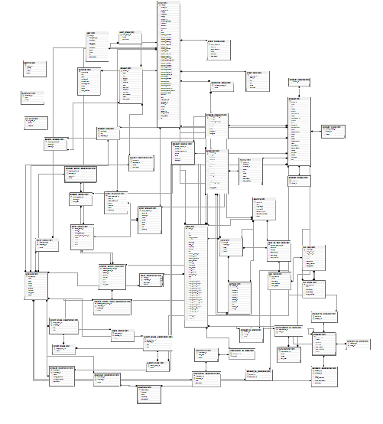

Slide 24
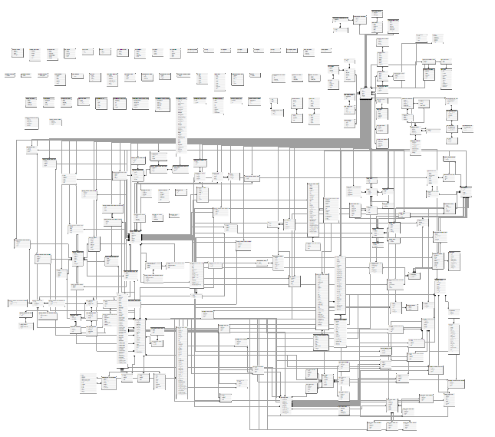

Slide 25
Collecting & searching data
Goodsway
Search engine includes:
Spider
Indexer
Search

Slide 26
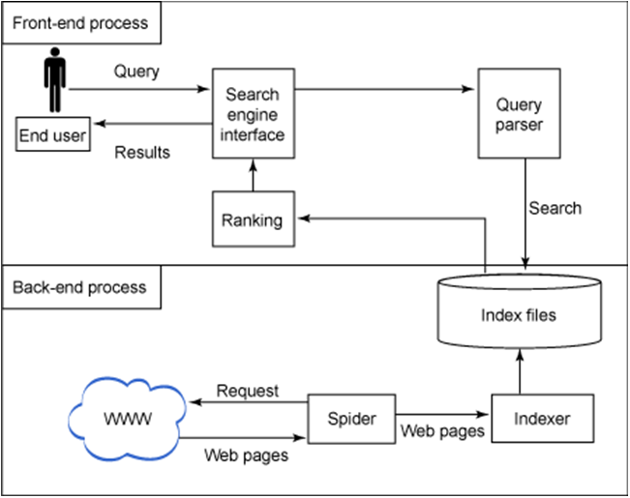
Collecting & searching data
Goodsway

Slide 27
Collecting data
Goodsway
Which data needs to collect?
Information about:
Manufactures, Companies
Distributors, Stores, Agents
Goods
Articles related:
Analysis goods
Consumer’s opinions
Shopping experience

Slide 28



Collecting data
Goodsway
Spider’s Tasks:
Statistical analysis
Insert to database
Resource discovery

Slide 29
Collecting data
Goodsway
The problems to resolve:
Dirty information
Distinguishing information concerning goods
Network resource and server load
Updating overhead
Bad implementations

Slide 30







Indexer & Search
Goodsway
Indexer
Server
Spider
DB Index
DB Product
User

Slide 31
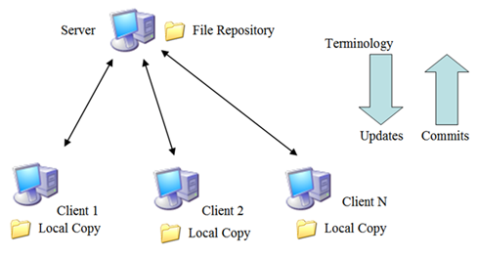
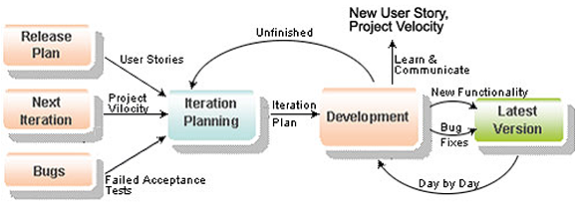
Implementation & Testing
Goodsway
Controlling and Monitoring
Source code
Code repository
Subversion
Team member
Meeting
Assign task
Tracking task
Issue resolve
Review task
Report
Agile method

Slide 32
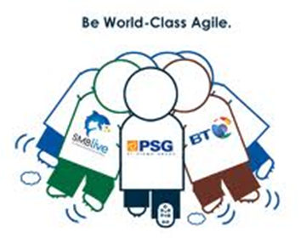
Implementation & Testing
Goodsway
Communication control
Online activity
Email
Google group
Chat
Phone
Offline activity
Kick-Off project
Daily and weekly meeting
Working together from Mon to Sat
Team building

Slide 33
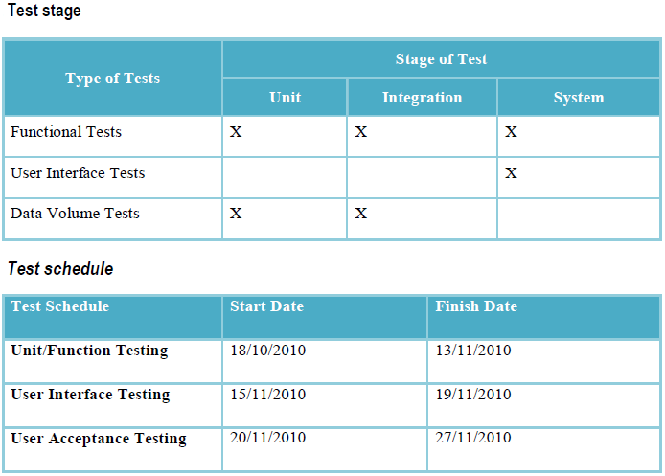
Implementation & Testing
Goodsway
Test Plan

Slide 34
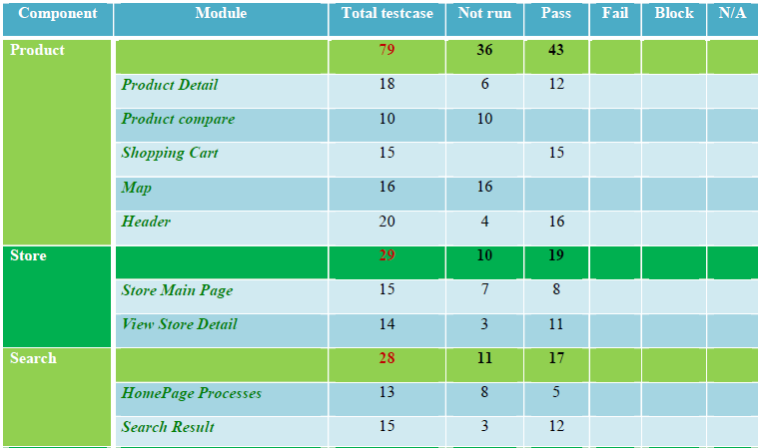
Implementation & Testing
Goodsway
Test Summary

Slide 35
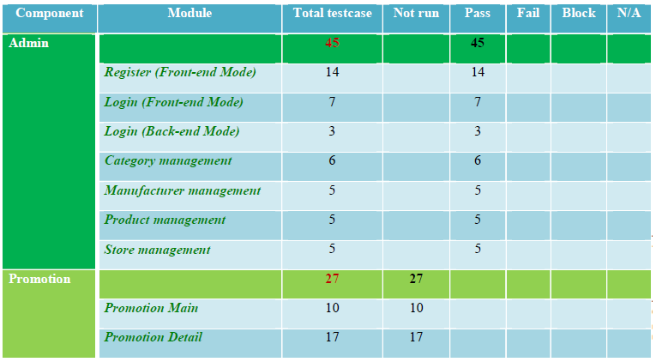
Implementation & Testing
Goodsway
Test Summary

Slide 36


Slide 37
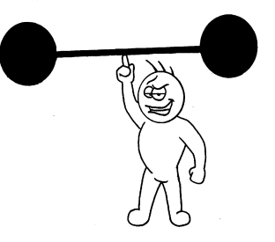

Summary
Goodsway
Strong point
Creative
Active
Cope with change
Weak point
Lack of technical skill
Lack of management skills
Lessons learned
Improve technical & management skills
Release on-time product with the restriction of time and resource
Improve communication skills & problem solving

Slide 38

Goodsway
Summary

Slide 39
Thank You !

